Slide 1

Maximizing Taxi Driver Revenue
Payment Type Analysis & A/B Testing
Karthick

Slide 2

The Problem & The Goal
The Challenge
Our Mission
In the competitive taxi sector, maximizing driver revenue is essential for long-term success and driver satisfaction.
Using data-driven insights to determine if payment type has a significant impact on taxi fare revenue.

Slide 3

Project Objectives
Problem Statement
Objective
Research Question
In the competitive taxi sector, maximizing driver revenue is essential for long-term success and driver satisfaction.
Run an A/B test (two-sample t-test) to examine the relationship between total fare and payment method.
Can we nudge customers towards a payment method that generates higher revenue, without harming customer experience?

Slide 4

Data & Methodology
Cleaning and preparing 200,000 New York Yellow Taxi trip records for analysis.

Slide 5

Key Data Cleaning Steps
01
02
Filter Payments
Clean Invalid Data
Isolated the dataset to only "Card" (65%) and "Cash" (34%) payments, as these are the two groups for our A/B test.
Removed all trips with $0 fares, 0-minute durations, or 0-mile distances to ensure the integrity of the analysis.
03
Remove Outliers
Applied the Interquartile Range (IQR) method to remove extreme outliers from fares, distance, and duration.

Slide 6
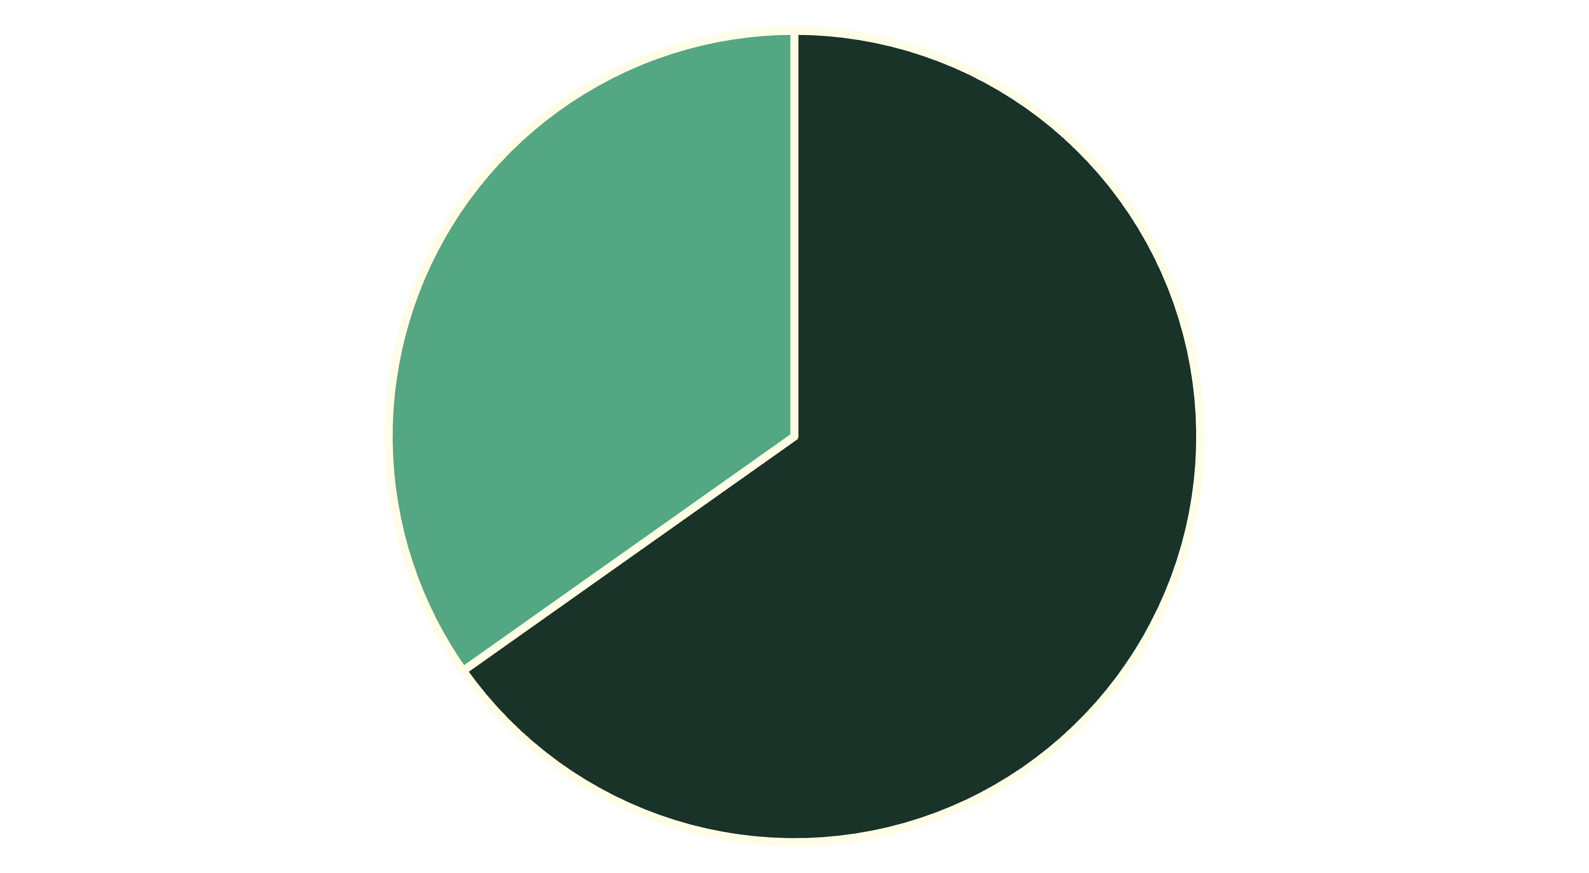
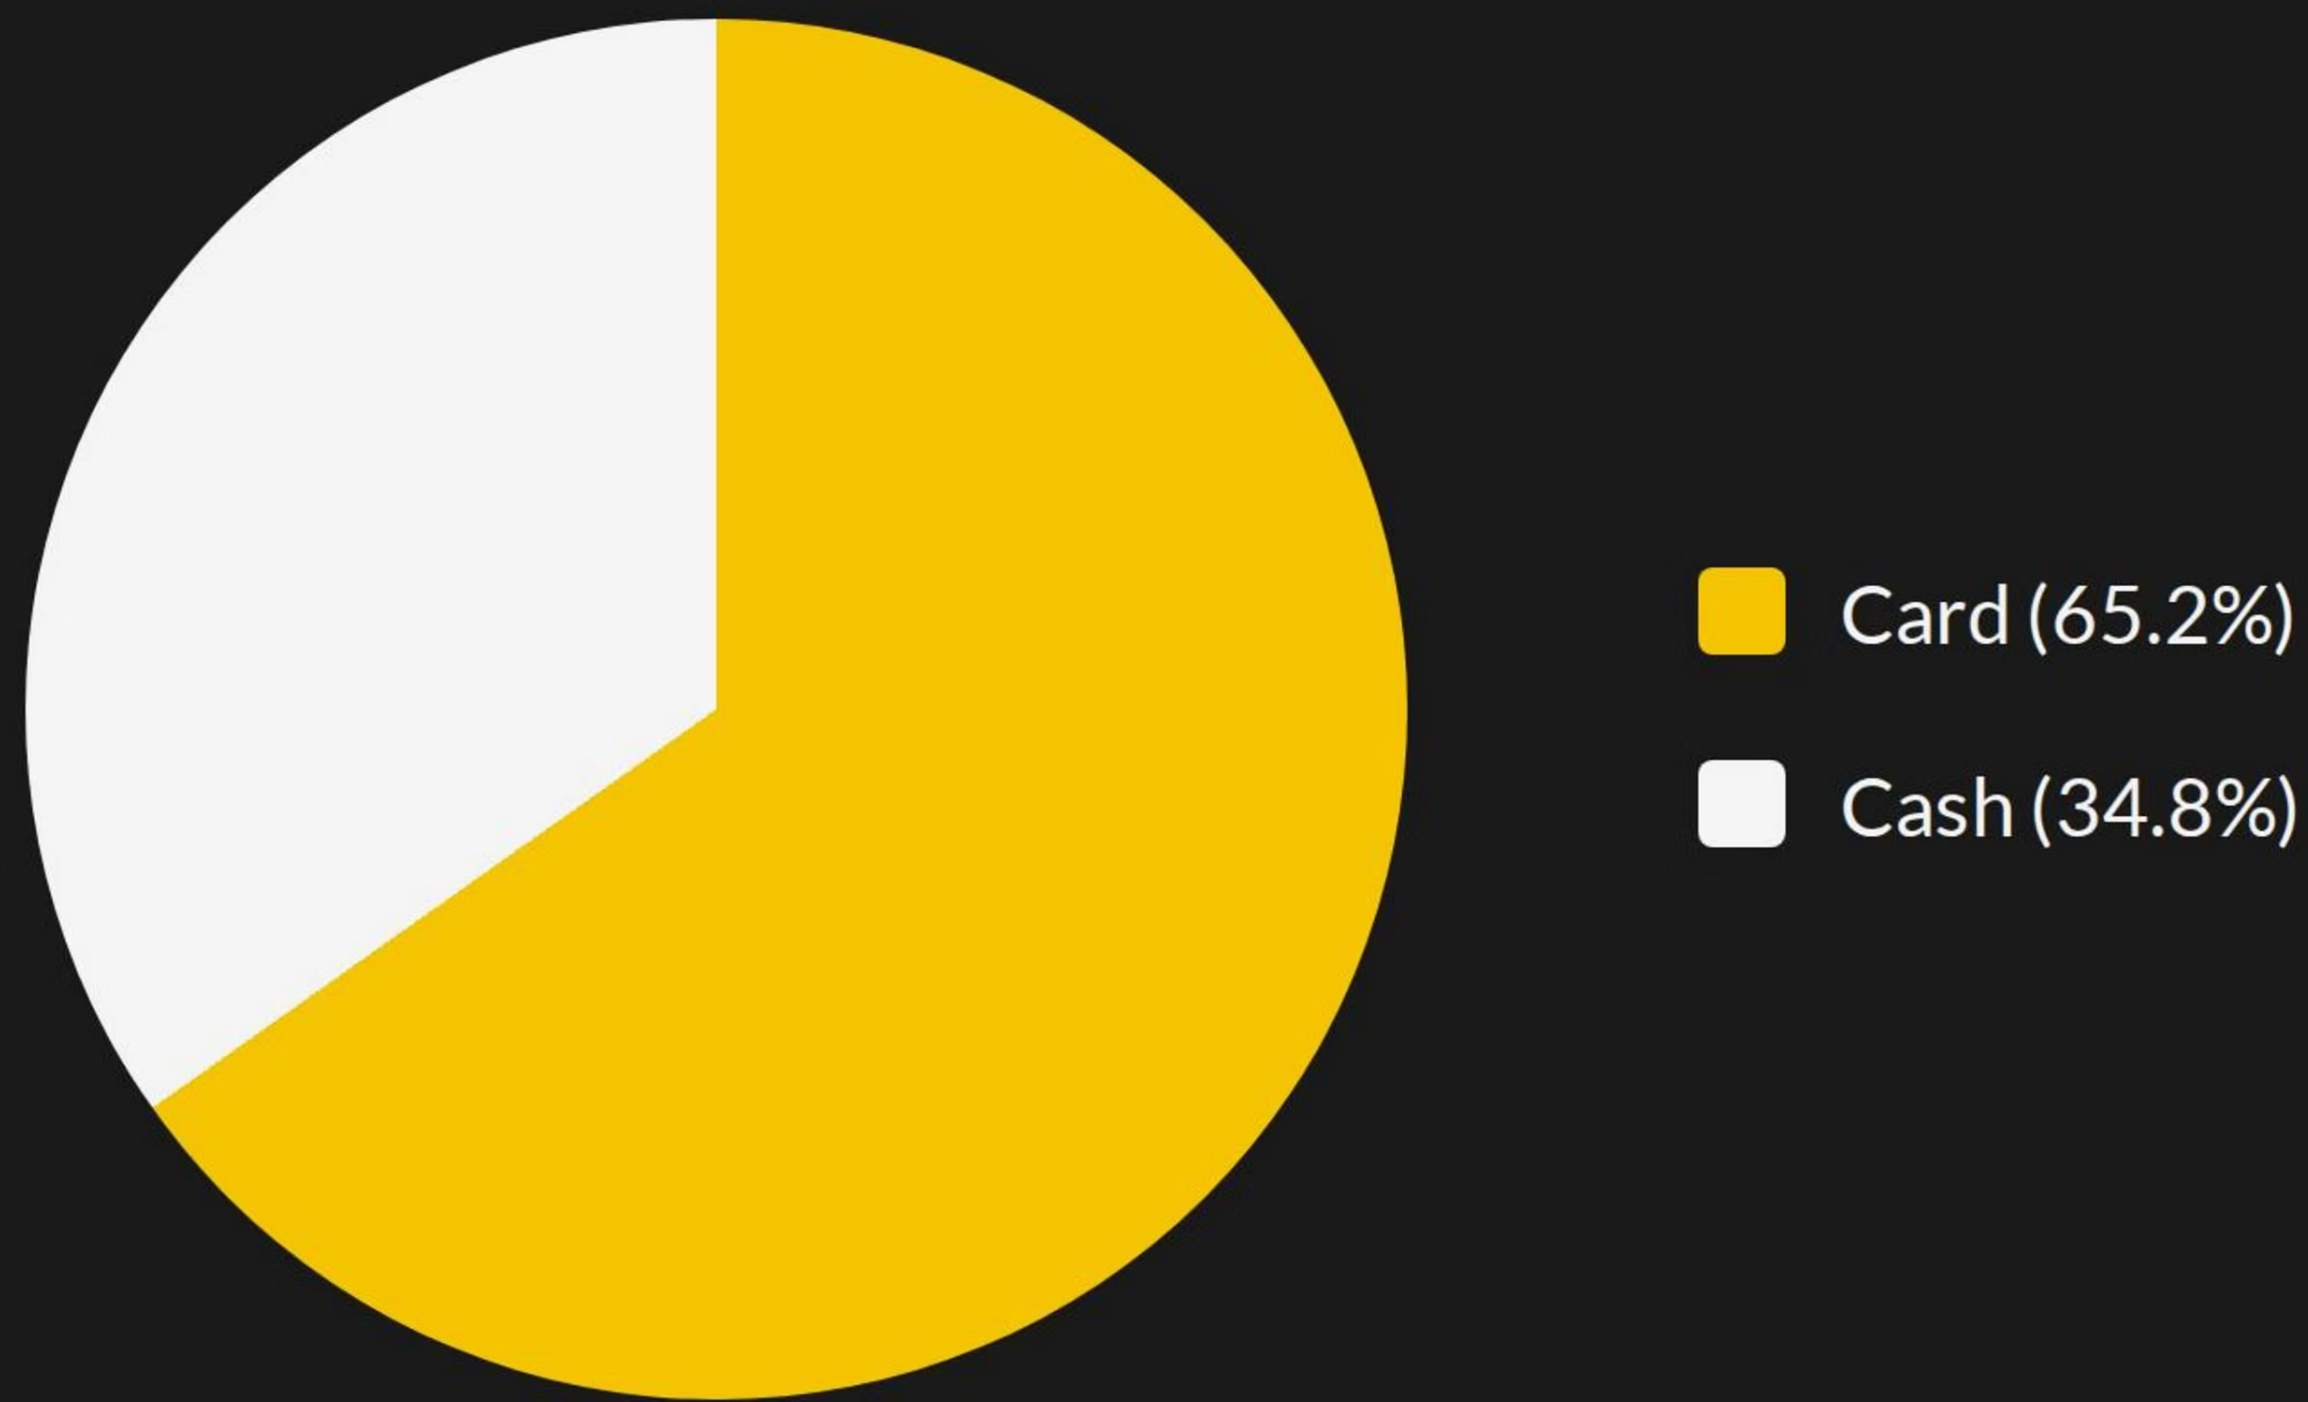
Payment Type Distribution
After filtering, Card payments are nearly twice as common as Cash payments in the dataset.
Card
Cash

Slide 7

Initial Findings: Average Fare
$9.08
$8.93
$0.15
Card Payments
Cash Payments
Difference
Is this real or random chance?
Average Fare (After outlier removal)
Average Fare (After outlier removal)

Slide 8
Formulating the Hypothesis
Null Hypothesis (H₀)
Alternative Hypothesis (Hₐ)
Significance Level (α)
There is no statistically significant difference in the average fare between card and cash payments.
We set our confidence level at 95%, so the significance level (α) is 0.05.
There is a statistically significant difference in the average fare between card and cash payments.

Slide 9

The Verdict
P-Value
Result
p < 0.001
Reject the Null Hypothesis
Exact P-value: 2.856e-12
The p-value is significantly smaller than our 0.05 threshold.
Interpretation
The $0.15 difference is highly statistically significant and not due to random chance.

Slide 10
Conclusion & Recommendation
Conclusion
Recommendation
The A/B test confirms that Credit Card payments generate a significantly higher average fare than Cash payments.
To maximize revenue, the taxi service should implement strategies to nudge customers towards using credit cards or other digital payment methods as their preferred option.
Thank You
Karthick | karthickwill05@gmail.com

